Slide 1
Heart+ : smart heart care
Jaypee University Of Engineering And Technology, Guna
Minor Project Presentation
Project no. : NJ2
Mentor – Dr. Neelesh Jain

Slide 2
Block Diagram
Data collection
Data preprocessing
Model training
Front-End Interface
Prediction

Slide 3
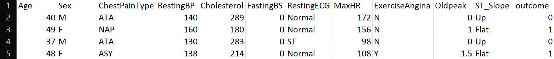
Data Collection
Source : The dataset was sourced from Kaggle, a popular platform for machine learning datasets and competitions.
Description: This dataset includes various features related to heart disease diagnosis, such as age, cholesterol levels, and exercise habits.
Link: [Heart Disease UCI Dataset on Kaggle] (https://www.kaggle.com/datasets)

Slide 4
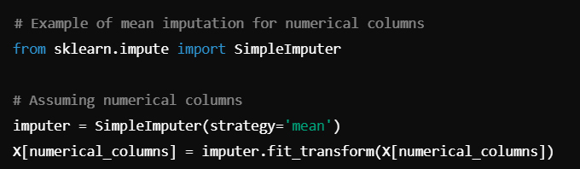
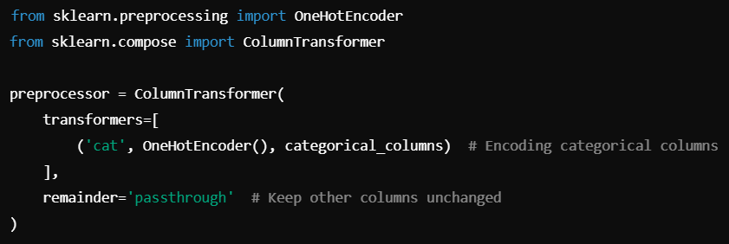
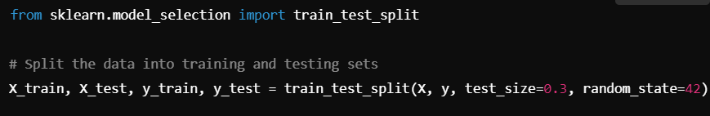
Data Preprocessing
Steps Involved:
- Handling missing values.
- Encoding categorical data
(gender)
- Splitting into training
and testing datasets
- Libraries Used: Pandas,
Scikit-learn, NumPy, Matplotlib

Slide 5
Machine Learning Model Overview
• Model Selection: Random Forest model uses decision trees and bagging to analyze data. It can handle large data sets and thousands of input variables . It has a higher true positive rate than logistic regression, but also has a higher false positive rate for datasets with more noise variables. | • Training Process: Train model on health indicators to predict heart disease risk
• Correlation Analysis: Features influencing the model's predictions significantly. | • Evaluation Metrics: Accuracy, Precision, Recall, F1-score

Slide 6
Front-End Implementation (Streamlit)
• Overview: User inputs health indicators, model returns risk prediction
• Key Code Snippet: Interactive elements (input fields, sliders, buttons)
• Explanation: How users interact with the app

Slide 7
Use of Project
• Practical Application: Early prediction of heart disease risk
• Impact: Empowering users with AI-driven insights to prevent heart disease
• Long-term health benefits and reduction of cardiovascular disease rates

Slide 8
Project no. - NJ2
Group members-
Shreya Sharma (221b370)
Paras Jain (221b260)
Vishvajeet Adavkar (221b450)

